Slide 1
Resilience Radar
Who does Luxembourg depend on?
STATEC HACKATHON 2026 · TEAM PROPOSAL
An interactive tool on Eurostat trade data that makes Luxembourg's supply dependencies visible, over time and on the map.
National Resilience Strategy
Energy shock 2026
Trade friction
Adopted Sept 2025. Pillars 3 and 4 call for fewer dependencies, supply chain transparency and regular assessment.
The Hormuz crisis exposed import dependencies. The PM named them in his State of the Nation speech.
US tariffs hit metals exports. STATEC already tracks the exposure. We make it a tool.
Options weighed: PNEC monitor · Energy shock · Resilience Radar (chosen) · Digital imports · Product space
Sources: National Resilience Strategy (HCPN, 2025) · State of the Nation 2026 · STATEC Conjoncture Flash
Notes:
Open with the policy anchor, not the data. The government adopted a National Resilience Strategy in September 2025. Pillars 3 and 4 ask for reduced dependencies, supply chain transparency and a regular assessment of resilience, but nobody has a tool that shows it in trade data. The 2026 energy shock and US tariffs make it urgent. We looked at five options; the Radar links the most current topics and fits the challenge's geo and time requirements best.

Slide 2
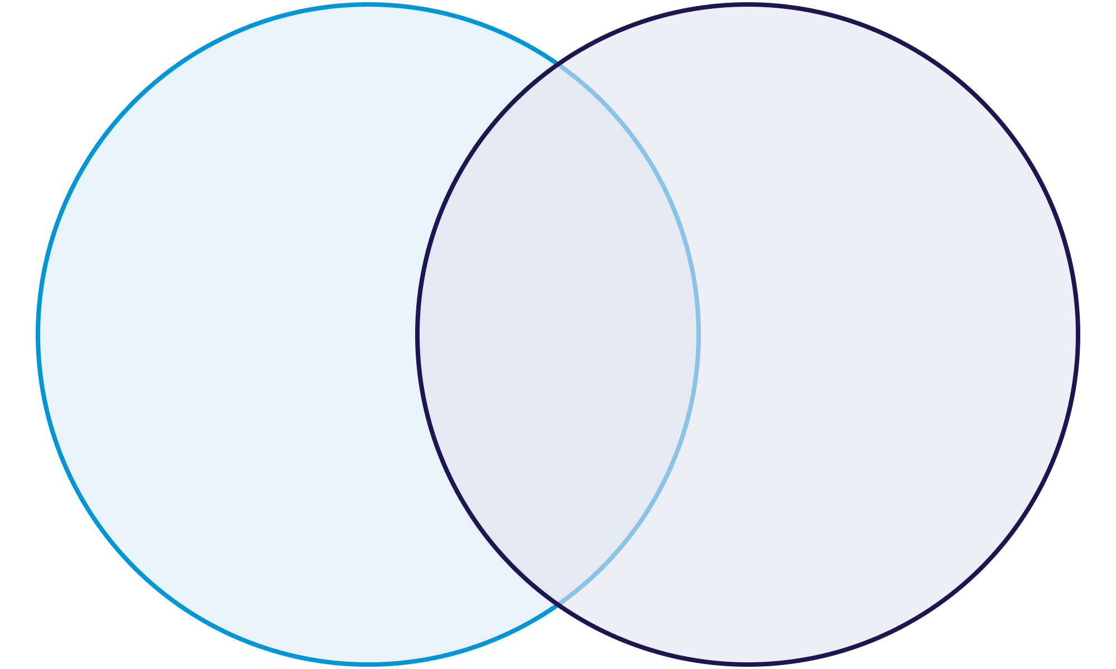
Where our tool sits
NATIONAL RESILIENCE STRATEGY · 8 PILLARS
3 · Essential goods & critical entities
4 · A resilient economy
CIVIL
MILITARY
5 · Strategic & logistical resources
5
PILLAR 4 · KEY ACTION 3
1
2
“A de-risking strategy and supply chain transparency will help to reduce critical dependencies.”
6
8
3
4
7
NEXT STEPS
Our tool sits here
“The country's level of resilience should be regularly assessed.”
The Radar is that monitoring instrument.
Source: National Resilience Strategy (HCPN, approved 12 Sept 2025), pp. 9, 27, 42 · diagram redrawn
Notes:
This is the strategy's own diagram: civil preparedness on the left, military on the right, cross-cutting pillars in the overlap. Our Radar is the data layer for pillars 3, 4 and 5: essential goods, a resilient economy, and strategic resources. The strategy itself asks for supply chain transparency to reduce critical dependencies, and for a regular assessment of the country's resilience. That is exactly what the Radar delivers: not a one-off chart, but a monitoring instrument that STATEC can update with every new month of data.

Slide 3
Resist. Adapt. Recover.
THE IDEA · BUILT ON THE STRATEGY'S OWN DEFINITION
Resist
Adapt
Recover
How spread out are our suppliers per product?
When a source fails, do we switch to others?
How fast do flows return to normal?
Metric: months back to pre-shock level, seasonally adjusted · Time
Metric: supplier concentration (HHI), extra-EU share · Map
Metric: shift in partner shares after a shock · Flows
BASKETS
Energy · Food · Health & medicines · Raw materials · Tech (from Pillar 3)
STRESS TESTS
COVID 2020 · Gas crisis 2022 · Hormuz 2026
DRILL-DOWN
Basket → partner → product, HS2 down to CN8
Definition: "the ability of a system to resist, adapt and recover from disruptions" (National Resilience Strategy, 2025) · Data: Eurostat ds-045409
Notes:
Our framework is not invented: it is the strategy's own definition of resilience, turned into three measurable lenses. Resist is about concentration of supply, shown on a map. Adapt asks whether partner shares shift after a shock. Recover measures how many months flows need to get back to pre-shock levels, after removing seasonal effects, which answers the challenge's seasonality question. The baskets come straight from Pillar 3's list of essential goods. Three real shocks give us natural stress tests.

Slide 4
Four workstreams, four known risks
THE PLAN · DEMO BY FRIDAY 10:30
Data · [names]
Eurostat extract: LU, neighbours, EU27, from 1999, monthly
Risks we name upfront
Metrics · [names]
Partner ≠ origin. Belgium and the Netherlands act as hubs: flag them, show extra-EU separately.
HHI, partner shifts, seasonal adjustment, recovery time
Concentration ≠ risk. Relying on neighbours is not fragile: weight partners transparently.
App · Martin + Nour
Interactive radar, map, drill-down; open repo, EUPL-1.2
Goods only. Finance and ICT services are out of scope: say so once.
Pitch · [name]
Confidential CN8 cells. Aggregate to HS4/HS6 where values are suppressed.
Story and deck; coaching slot Thursday from 13:00
Fallback if time runs short: Resist + one stress test (Hormuz 2026) only
Notes:
Split the work by strength: statisticians own data and metrics, the app is built in parallel with Claude, one person owns the story. Name the risks ourselves before the jury does: partner country is not country of origin, concentration on neighbours is not automatically a risk, trade data cover goods only, and some CN8 values are confidential. Fallback: if time runs short we ship Resist plus the 2026 stress test.

